Slide 1
Notes:
September 23-25, 2019

Slide 2














Your platform for building anything
DESKTOP
WEB
CLOUD
MOBILE
GAMING
IoT
AI
.NET
Notes:
You can build anything with .NET.
.NET Core 3 adds more features to complete the story: web, cloud, mobile, games, IoT, and AI

Slide 3

RELEASED
.NET Core 3.0
WPF and Windows Forms support
Side-by-side support & self-contained EXEs
Full-stack web development with C# and Razor
New C# 8.0 language features
dot.net/get-core3
Notes:
.NET Core 2.0 Focus
Console Applications, Entity Framework Core, ASP.NET MVC, Razor Pages, and WebAPI
.NET Core 3.0 Focus
Windows Forms, WPF, COM Support(Windows only). Entity Framework 3.0, EF 6.3, gRpc, Work Services, Blazor Server Side
NET Core 3.0 is also the first .NET runtime to fully support C# 8.0

Slide 4
RELEASED
Visual Studio 2019 version 16.3 Visual Studio 2019 for Mac version 8.3
Support for .NET Core 3.0 and C# 8.0
New .NET productivity improvements
More performance improvements
iOS 13 & Android 10 support
visualstudio.com/downloads
Notes:
We’ve also just released some updates for Visual Studio 2019 version 16.3 and Visual Studio 2019 for Mac version 8.3!
Both add support for .NET Core 3.0 and C# 8.0, have many productivity and performance enhancements and have support for building iOS 13 & Android 10 mobile apps.
In particular, Visual Studio:
- Adds support for creating WPF and Windows Forms desktop applications with .NET Core 3.0, alongside ASP.NET Core web and Blazor applications, gRPC services, and much more.
- You can publish .NET Core 3.0 worker projects to Azure Container Registry, DockerHub, and elsewhere.
We also added for targeting .NET Framework 4.8 and F# 4.7.
Multiple productivity improvements were added for .NET developers, like more refactorings and search capabilities.
With Visual Studio 2019 for Mac:
We enhanced productivity with new C#, Web and XAML editors

Slide 5
C# 8.0
Safe
Nullable and non-nullable reference types help you write safer code
Declare your intent more clearly
Modern
Async streams for modern workloads like cloud & IoT communication
Easily work with cloud scale datasets using indexes and ranges
Productive
Write less code using patterns
Protect data with readonly members
Improved using statements for resource management
Notes:
Nullable reference types
Improvements to pattern matching (tuple and switch patterns)
Positional patterns
Property patterns
Asynchronous streams
Ranges and indices
Using declaration
Static local functions
https://www.dotnetcurry.com/csharp/1489/csharp-8-visual-studio-2019

Slide 6
Improvements:
Async enumerables
More patterns in more places
Default interface members
Indices and Ranges
Using statement
Static local functions
Readonly members
Null coalescing assignment
Unmanaged constraint
Interpolated verbatim strings

Slide 7
Entity Framework Core 3.0

Slide 8
What’s new in EF Core 3.0
LINQ overhaul
New architecture
Constrained client evaluation
Single SQL query per LINQ query
C# 8 support
Async streams
Nullable reference types
Cosmos DB provider
Database interception
Notes:
Gotcha: I have ported several ASP.NET projects and there are some queries that worked in EF Core 2.x might not work as written in EF Core 3.0.
EF 2.0 would run some linq queries on both sever and client and EF 3.0 will now throw an error. My Issue was use of a GroupBy clause.

Slide 9
Use EF Core 3.0 unless porting use EF 6.3
Happy with EF 6 features and performance, but need to move to .NET Core?
No new features (but some community PRs)
No SQL Server spatial on .NET Core
No EF designer support yet
Providers will need to port to .NET Core

Slide 10
.NET Core 3.0 for Windows Desktop

Slide 11
.NET Core 3.0 for Windows Desktop
Deployment Flexibility
Side-by-side deployment, self-contained EXEs
Install machine global or app local framework
Windows 10
Access modern Windows 10 APIs from WPF and WinForms
Use native Windows 10 controls via XAML islands (Host UWP components)
Open Source
WPF and WinForms projects also open source on GitHub
Take advantage of performance, runtime and API improvements happening in .NET Core
Notes:
Support for Windows Desktop (Windows Forms/WPF fully compatible with their .NET framework counterparts.)
Can be ported to .NET Core unless they depend on some other feature that is not supported in .NET Core, such as .NET Remoting or advanced WCF features
Porting is not trivial and requires some changes to the source code.
The designers in Visual Studio 2019 don’t work yet on .NET Core projects.

Slide 12
How to choose: .NET Framework or .NET Core?
New apps
.NET Core
Completed apps in maintenance
OK to leave on .NET Framework
Existing apps in active development
Consider porting to .NET Core

Slide 13
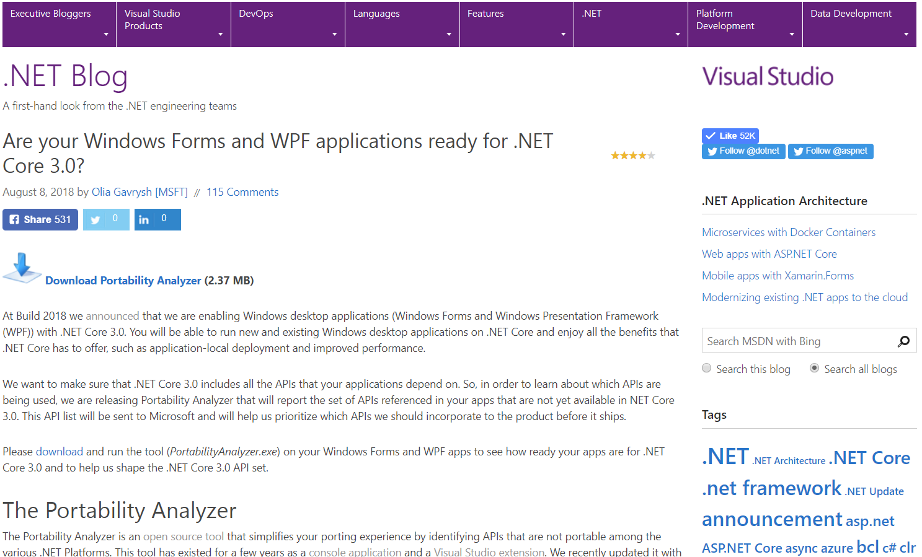
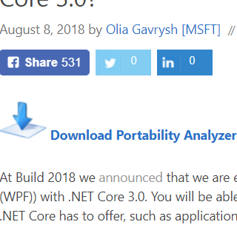
How compatible is my app with .NET Core?
Portability Analyzer
will show all APIs from your code that are not in .NET Core 3.0
https://aka.ms/portabilityAnalyzer

Slide 14
RELEASED
App Center for .NET Core 3.0 Windows Apps
Easily deploy your app to your QA teams, testers, and app stores
Collect real-time app diagnostics data, prioritize and fix issues faster
Track usage patterns, user adoption, and other engagement metrics
Now supports WPF and WinForms apps on .NET Core 3.0
Appcenter.ms
Notes:
And to make deploying, testing and collecting telemetry easy, we’re announcing today the release of .NET Core 3.0 Windows Apps support in App Center.

Slide 15
Deployment
Before .NET Core 3.0, only self-contained deployments included an executable. Framework-dependent
deployments had to be run with dotnet command line tool. In .NET Core 3.0, framework-dependent
deployments can also include an executable for a specific target platform.
Self-contained deployments support assembly trimming.
Both Creation of single-file executables
Two-tier JIT & Ready-to-run images.

Slide 16
.NET Core 3.0 ASP.NET & Blazor

Slide 17
ASP.NET Core 3.0
gRPC
High performance contract-based RPC services with .NET
Works across many languages and platforms
Worker Service
Starting point for long running back processes like Windows Server or Linux daemon
Producing or consuming messages from a message queue
Web API’s + Identity
Add security and authentication to Web API’s
Notes:
Worker Service - ASP.NET Core application hosting long-running background processes instead of responding to client requests.
On Windows, the application can act as a Windows Service.
On Linux, it can run as a systemd service
We’ve added a ton of features to ASP.NET Core in version 3.0 on order to make building resilient microservices easier.

Slide 18
ASP.NET Core 3.0
Several libraries were removed from the basic SDK and must now be added manually when needed.
Endpoint routing for better routing with middleware.
Replaced JSON.NET as the library for serializing and deserializing JSON
Notes:
1. JSON.NET as the library for serializing and deserializing JSON has been replaced with a built-in JSON library with focus on high performance and minimal memory allocation. JSON.NET can still be installed into the project and used instead.
2. To make applications smaller by default and reduce the number of dependencies, several libraries were removed from the basic SDK and must now be added manually when needed.
3. Endpoint routing which was first introduced in .NET Core 2.2 has been further improved. Its main advantage is better interaction between routing and the middleware.
4. ASP.NET Adding features are more granular. Use Routing, Endpoints, Razor Pages and etc.
** Gotchas: Order now matters .UseRouting() must occur before you add Identity/Authorization. Areas that require authorization will stop working and anyone can get to previously protected areas.

Slide 19
Migrating to ASP.NET Core 3.0
Notes:
1. Linq Changes - will not combine server side and client side queries.
2. No more Microsoft.AspNetCore.All package, Add individual feature packages as needed.
3. Follow the Migration Documentation closely: https://docs.microsoft.com/en-us/aspnet/core/migration/22-to-30?view=aspnetcore-3.0&tabs=visual-studio
4. New Identity UI package project middleware template changes. (New Identity Area)
5. Changes to Host Builder program.cs && WebHostBuilder startup.cs
6. Improved JSON support, replaces need for JSON.NET package.
7. Startup changes order matters UseStaticFiles, UseRouting, UseCors, UseAuthentication, UseAutorization, UseEndpoints. (Wrong order and Identity will be broken, yet the website appears to work but is broken.)
8. Review the Breaking API changes section.

Slide 20
What’s new in gRC in .NET Core 3.0
Although a gRPC library for C# has been available for a while with first-class support with project templates
Notes:
gRPC is a modern high-performance contract-first RPC - alternative to wcf which has limited support in core 3. its performance benefits are most obvious when many RPC calls and large payloads are required. Although a gRPC library for C# has been available for a while, .NET Core 3.0 and Visual Studio 2019 now include first-class support with project templates and tooling to make development easier.

Slide 21
ASP.NET Core 3.0 Blazor
Full stack web development with C#
You don’t need to know AngularJS, React, Vue, etc.
Take advantage of stability and consistency of .NET
Runs in all browsers
Strongly typed on the client and server
Share C# code with the client and server
Web Assembly (In Preview, Release in May 2020)
Native performance
Requires no plugin or code transpilation
Notes:
Blazor is a new client-side web UI framework based on .NET and C# instead of JavaScript.
.NET has always had great support for building server-rendered web apps with ASP.NET, where your .NET code runs on the server and generates HTML & JSON responses. But if you ever wanted to add some client-side functionality to your web app that runs in the browser on the user's device, that meant you had to write some JavaScript.
Well, not anymore! Blazor enables full-stack web development with .NET using only open web standards. .NET Core 3.0 ships support for Blazor Server apps, which enables you to handle client-side UI interactions over a real-time SignalR connection. And in the near future with Blazor WebAssembly you'll be able to run your .NET code directly in the browser on WebAssembly-based .NET runtime.

Slide 22


Blazor
Build client-side web UI with .NET instead of JavaScript
Write reusable web UI components with C# and Razor
Share .NET code with both the client and the server
Call into JavaScript libraries & browser APIs as needed
Go to https://blazor.net
C#

Slide 23
.NET Core 3.0 & Raspberry Pi

Slide 24
.NET Core 3.0 IoT Support
Supports Raspberry Pi and other devices
You can now run .NET Core apps in small places, including ASP.NET
Read sensor data & write to displays
New APIs for GPIO pins that enable using millions of IoT peripherals
Works with containers
Deploy apps directly onto devices or with containers
Notes:
Clarify that we support ARM32/ARM64 (that’s for the Pi and friends) but also x64 for devices that need more horse power. This matches the IoT edge offering
We offer a new API, in this package: https://www.nuget.org/packages/System.Device.Gpio. Supports GPIO, PWM, SPI and I2C.

Slide 25
ML.NET
Built for .NET developers
Create custom ML models using C# or F# without having to leave the .NET ecosystem
Custom ML made easy with AutoML
Visual Studio Model Builder and CLI make it super easy to build custom ML Models
Extended with TensorFlow & more
Leverage other popular ML frameworks (TensorFlow, ONNX, and more)
Notes:
Support for new scenarios such as Sales Forecasting, Anomaly Detection
General availability of TensorFlow and ONNX support
Preview: Native database loader that enables training directly against relational databases
Preview: Build custom deep learning models using Tensorflow
Support .NET Core 3 - New scenarios in Model Builder - GitHub Issue classification
"and we're working on adding some cool stuff, which we'll show you an example of in the next demo" .. or something like that (because deep learning for Model Builder won't be released for a while)

Slide 26
.NET Release Schedule

Slide 27
.NET Schedule
July 2019
.NET Core 3.0
RC
Sept 2019
.NET Core 3.0
Nov 2019
.NET Core 3.1
LTS
Nov 2020
.NET 5.0
Nov 2021
.NET 6.0
LTS
Nov 2022
.NET 7.0
Nov 2023
.NET 8.0
LTS
.NET Core 3.0 released today!
.NET Core 3.1 = Long Term Support (LTS)
.NET 5.0 release in November 2020
Major releases every year, LTS for even numbered releases
Predictable schedule, minor releases if needed
Notes:
Explain – Long Term Support

Slide 28




.NET 5 (Nov 2020)– A unified platform
TOOLS
DESKTOP
WEB
CLOUD
MOBILE
GAMING
IoT
AI
WPF
Windows Forms
UWP
ASP.NET
Azure
Xamarin
Unity
ARM32
ARM64
ML.NET
.NET for Apache Spark
VISUAL STUDIO
.NET STANDARD
VISUAL STUDIO FOR MAC
.NET 5
VISUAL STUDIO CODE
INFRASTRUCTURE
RUNTIME COMPONENTS
COMPILERS
LANGUAGES
COMMAND LINE INTERFACE

Slide 29
Presentations from .NET Conf 2019 https://github.com/dotnet-presentations/dotnetconf2019/tree/master/Technical Migrating ASP.NET Core 2.x to ASP.NET Core 3.0 https://docs.microsoft.com/en-us/aspnet/core/migration/22-to-30?view=aspnetcore-3.0&tabs=visual-studio

Slide 30
Questions and Answers

